Slide 1

CS-510 Data Engineering Project Instructor: Mina Vu
Team Data Makers:
Jithendra Bojedla
Dileep Kumar Boyapati
Lakshmi Sai Prasanna Addagalla
Venkata Bhuvana Kancharla

Slide 2
Agenda:
Introduction
Architecture
Data Gathering
Implementation
Data volume
Visualization
Challenges

Slide 3
Introduction:
TriMet, short for the Tri-County Metropolitan Transportation District of Oregon, is a public agency that runs mass transit services in the Portland metro area.
It operates buses, the MAX Light Rail, and the WES Commuter Rail. TriMet aims to provide easy, reliable, and eco-friendly transportation, helping people get around and improving the quality of life in the region.
Connect people with valued mobility options that are safe, convenient, reliable, accessible and welcoming for all.
The main goal of this project is to build a pipeline that stores breadcrumb data using Pub/Sub and implements data visualizations.
Bhuvana

Slide 4
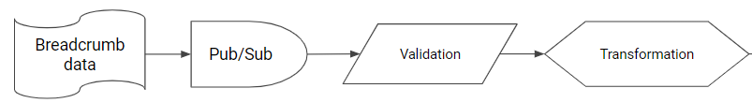
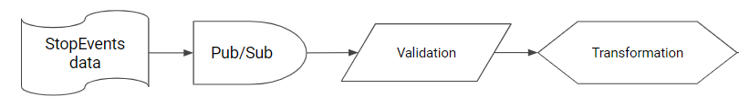
Architecture
Database
Trip
Trip
view
Breadcrumb
StopEvent
Data Visualization
Bhuvana

Slide 5
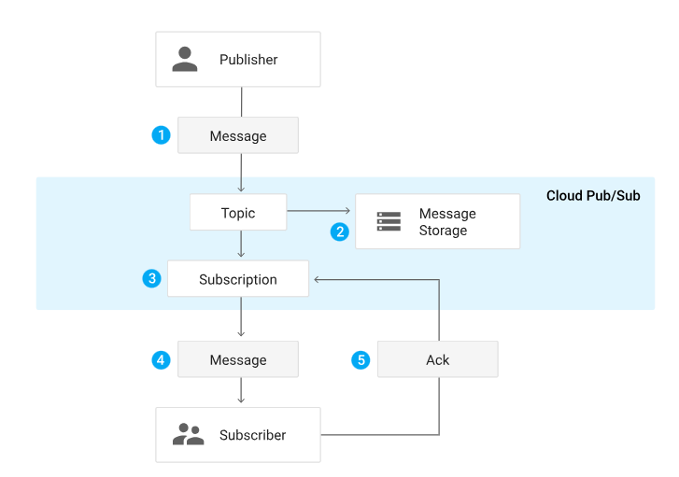
Pub/Sub Architecture:
Bhuvana

Slide 6
Data Gathering
Developed a system to monitor Trimet bus movements and locations.
Collected real-time bus data from the Trimet web server.
Implemented time-based job scheduling using cron for regular data retrieval and processing.
Utilized systemd service to ensure the continuous operation of the data consumer.
Enabled seamless and uninterrupted collection and processing of bus data for real-time monitoring and analysis.
Dileep Kumar

Slide 7
Implementation
Part-1
Set up Pub/Sub topics and subscriptions.
Modify the Python script to parse JSON and send records to Pub/Sub.
Created a Python program to receive Pub/Sub messages and write them to files.
Created a data pipeline capable of gathering TriMet breadcrumb data daily, transporting it to Pub/Sub, and storing it reliably for further processing and analysis.
Part-2
Defined 20 validation assertions in English. Implemented 10 assertions in code.
Calculated speed using breadcrumb timestamps and odometer readings. Transformed data to fit schema requirements.
Load transformed data into the database.
Part-3
Developed a new pipeline similar to the previous one, incorporating Cloud Pub/Sub, automation, validation, and loading.
Integrated stop events with breadcrumb data by updating the Trip table. Alternatively, load stop event data into a separate table and use SQL views for integration.
Transformed the data to geoJSON format and display map visualizations.
Jithendra

Slide 8

Data Volume in records:
Average daily data(12MB):
Weekdays - 120029
Weekend - 91114
Total(384MB):
BreadCrumb - 4112808
Trip - 19140
Stopevent - 536422
Prasanna

Slide 9
Visualizations

Slide 10
Generating map data:
Query the location(longitude and latitude) & speed data from the breadcrumb, trip, stopevent tables and integrated trip_stop view in your database server.
Export the results to tab separated list of values(tsv) files.
To represent geographical features, convert the data in tsv to geoJSON files.
Prasanna

Slide 11
Description & reason of choice:
Visualization 1
Traffic on weekdays between 5 to 6pm in the afternoon.
Reason: We wanted to check the complete visualization of trips on weekdays during evening rush hour (i.e 5 to 6pm).
Visualization 2
Entire trips on route number 6,8,9,12,14,17,19,35,54,99 on a particular day.
Reason: We wanted to visualize on buses connecting to PSU campus from different places within portland.
Prasanna

Slide 12
Queries:
Visualization 1
Select b.longitude, b.latitude, b.speed
FROM BreadCrumb b
JOIN Trip t ON b.trip_id = t.trip_id
WHERE extract(hour from b.tstamp)>=17
and extract(hour from b.tstamp)<=18
and DATE(b.tstamp) BETWEEN '2023-01-27' AND '2023-01-31';
Visualization 2
Select b.longitude,b.latitude,b.speed
from breadcrumb b,trip_stop_view t
where b.trip_id=t.trip_id
and t.direction = 0
and t.route_number in (6,8,9,12,14,17,19,35,54,99)
and date(tstamp) = date'2023-01-21';
Prasanna

Slide 13
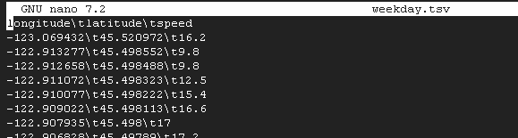
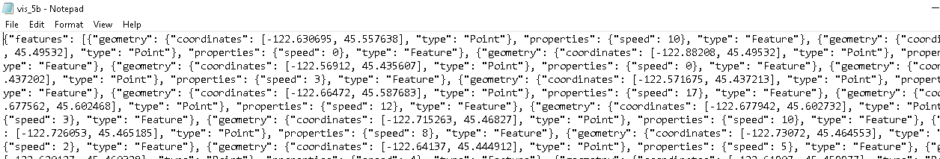
Sample tsv file:
Sample geojson file:
Prasanna

Slide 14
Displaying the map:
We used Mapbox GL JS which is a JavaScript library to create web maps.
It shows Mapbox maps in a web browser, helps to add interactive features, and customize how the map looks and behaves in your application.
Set up a simple HTTP server that serves geojson files on localhost(port 8000) or VM's external IP address
Prasanna

Slide 15
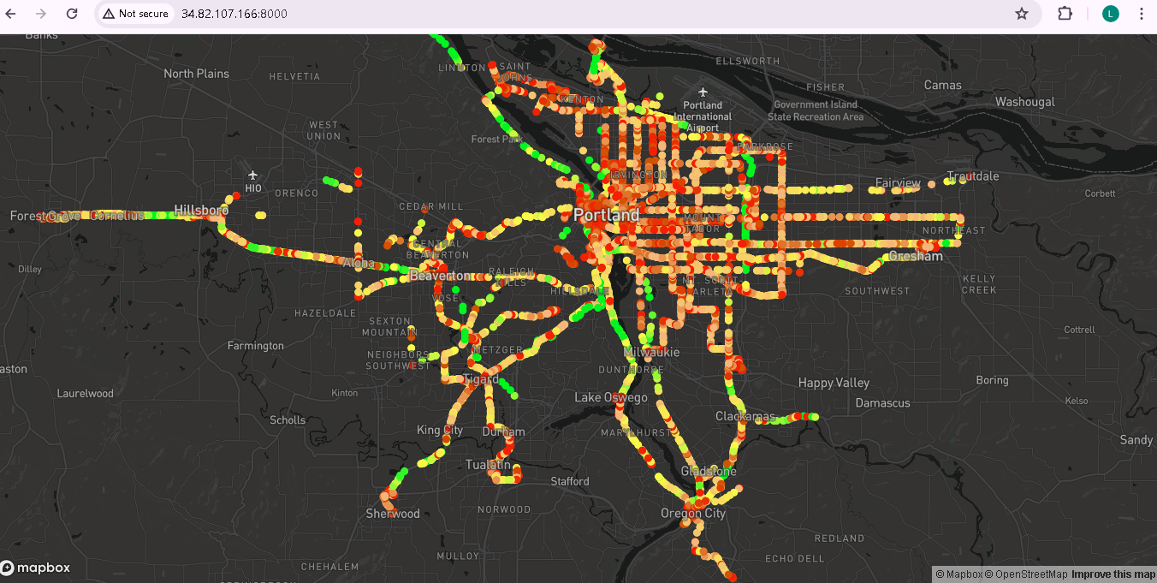
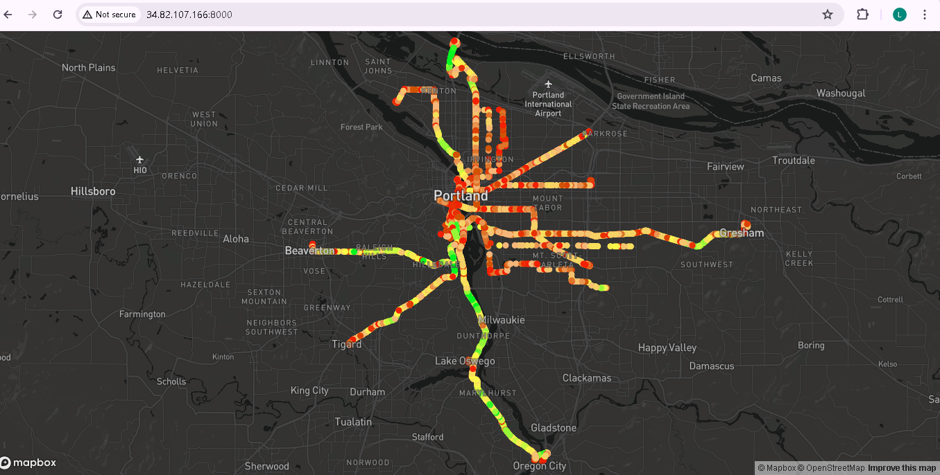
Visualization 1
Visualization 2
Prasanna

Slide 16
Challenges
Issues while transforming data
Integrating data from two pipelines
Bhuvana

Slide 17

Thank you!
Prof Mina & Prof Bruce

